Slide 1
SOA Communications
SOA was created by the industry to solve a problem: how to make disparate, diverse, and distributed services talk to disparate and diverse clients.
The final result of an SOA project isn’t the access of services, per se; it is the creation of a business process.
In a complex business project, the developers juggle many clients and many services, which can make visualization of the overall system difficult.
To address this problem, various modeling tools have been developed to support SOA development and optimization, system and process management, change and life-cycle management.
Several methodologies have been developed to model SOAs.
Working in a software package to model your business processes is similar in approach to designing and optimizing a relational database in entity-relationship, object-role modeling package, or another Computer Aided System Engineering (CASE) tool for data storage and equally as valuable.

Slide 2
Business Process Modeling
Unified Modeling Language (UML): The UML standard is the work of the Object Management Group (http://www.omg.org/).
UML creates graphical representations of software systems in the form of a set of diagram types. Elements in a UML architectural blueprint include actors, business processes, logic modules (components), program routines, database schemas, software components, and activities.
UML diagrams are separated into seven structural types and four behavior types; structure types model the components of the system, while behavior types model states, actions, and events.
UML is widely used in the industry for software system modeling. A developed system model can be reduced automatically to code.
XML Metadata Interchange (XMI): XMI is another standard of the Object Management Group (OMG) and is used to exchange metadata using the Extensible Markup Language (XML).
Metadata is structured into a meta model that fits into the OMG’s Meta-Object Facility. UML models often use XMI as their interchange format, although they can be used by other languages.

Slide 3
Business Process Modeling
XMI files are not generally interchangeable between the different modeling languages that can use them. XMI has been codified as an international standard by ISO, as IS0/IEC 19503:2005.
Systems Modeling Language (SysML) is an open-source extension of the part of the UML system dealing with profiles. It is smaller, more focused, and easier to learn and work with than UML itself. SysML reuses 7 of UML 2.0’s 13 diagrams.
The effort to develop SysML was rolled into OMG in 2008, but remains open source. SysML can use XMI and is developing toward support of ISO 10303, which is the Standard for the Exchange of Product Model Data (STEP) AP-233.
Business Process Modeling Notation (BPMN) is a methodology for representing business processes as a set of connected visual objects that illustrate workflow in a Business Process Diagram (BPD).
Originally developed in the Business Process Management Initiative (BPMI), it was incorporated into the Open Management Group in 2005.
A BPD can be reduced to the OASIS standard WS-Business Process Execution Language, which is an executable language for information transfer between different Web services.

Slide 4
Business Process Modeling
Service-Oriented Modeling Framework (SOMF): This framework was proposed by Michael Bell and combines a modeling language with a graphical display of the various SOA components so the system can be viewed as a map of objects and associated relationships.
SOMF software allows developers to create an action plan to implement their business processes and can be valuable in system and architecture optimization, tracing message pathways, positioning software assets correctly, and providing a language for describing through abstraction and generalization how the processes operate.
SOMF soft-ware not only allows you to determine what needs to be done, but also allows you to run “what-if” scenarios to see how changes will impact your SOA system.
SOMA reduces services to a set of service objects and breaks down relationships into three components: the services themselves, the service components that make use of those services, and the information flows required to interact between them.
Flows consist both of processes as well as their internal composition. In SOMA, domains and functional groups are identified, variables that affect processes are analyzed, and component development and object oriented analysis are used to model specific cases. SOMA is meant to provide information on service and service boundaries, service granularity, and asset analysis.

Slide 5
Business Process Modeling
In SOMF, the modeling is based on the elements of the service life cycle:
Conceptualization: Defining the processes that will be supported
Discovery: Determining how components are exposed
Analysis: Identifying the relationships services have to clients
Integration: Implementing the messaging infrastructure that connects clients to components
Logical design: Building the system and process logic and determining how orchestration or choreography will be performed
Architecture design: Creating the system component architecture and reducing design to software components with specified interfaces
System implementation: Building and testing the system components

Slide 6
Business Process Modeling
Four modelling topologies for message passing are used in SOMF:
Circular topology: A circular topology is one where message passing is carried out in a circular fashion.
There is no orchestrator in this system, and each component providing a service is responsible for knowing which message to act on and where to send a message next. That is, the choreography of the system is maintained at the component.
Hierarchical topology: In a hierarchical topology, services are arranged in a tree pattern with parent/child relationships.
Messages from one service to another must traverse up the branch of the tree and down another branch from the root until the matching service is found. Hierarchical topologies offer the advantage of a well-defined set of relationships, a central location (the root) where logic may reside, and a clearly stated address space.
The disadvantage of a hierarchical topology is that the overhead of passing a message from one service to another isn’t optimized.

Slide 7
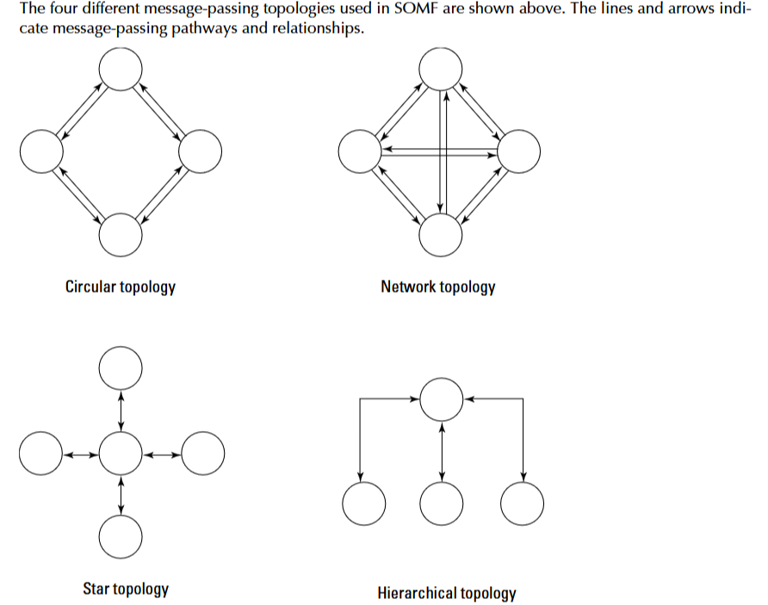
Business Process Modeling
Network topology: A network topology has a many-to-many relationship between services and their clients.
The advantage of a network topology is that the overhead associated with message passing has been minimized but there is considerable overhead built into the system in order to maintain the many links needed.
Star topology: In a star topology, services are designed to connect through a central service. The star model is favored in orchestration processes and is useful for services that use broadcasting or multicasting services, publish and subscribe, and other related systems.

Slide 8
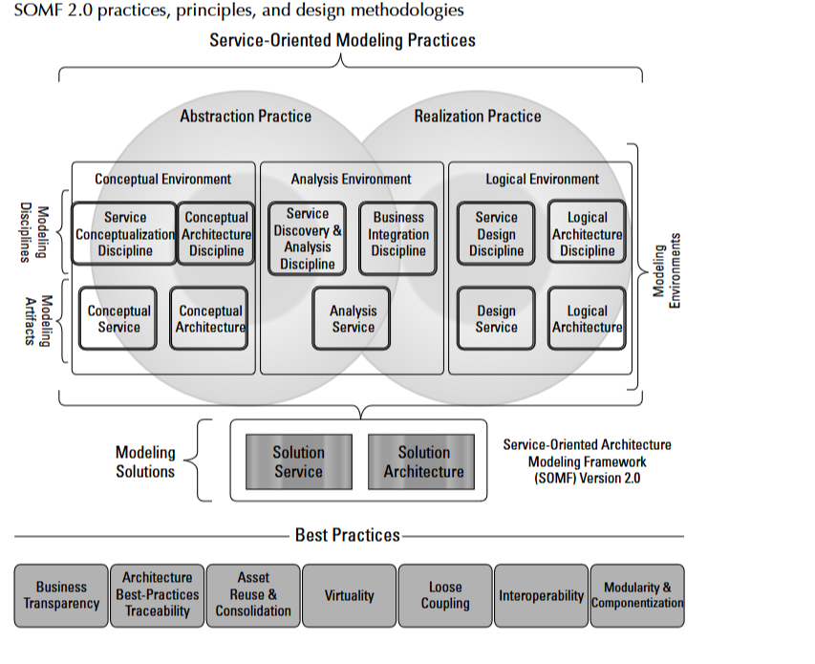
Business Process Modeling

Slide 9
Business Process Modeling
A service in SOMF that is granular and very narrow in scope is referred to as an atomic service. An atomic service cannot be decomposed into smaller services that provide a useful function.
An example of an atomic service is a customer lookup that contains a customer ID and the customer’s name and address. An address that doesn’t contain the customer’s name or lists a customer name without an ID wouldn’t have much value, so this service stands alone.
A service that provides ID, name, and address might be part of a set of services that describe a bank account, customer purchase record, or any number of services. A collection of services that work together is referred to as a composite service.
The Enterprise Service Bus described previously in this chapter is another example of a composite service; it contains functions for message routing, message interchange and translation, and process orchestration.
A composite service is usually organized as a hierarchical topology and is multifunctional or a coarse-grained entity. SOA describes a distributed collection of services performing business process functions.

Slide 10
Business Process Modeling
A collection of composite services that would form a process module is referred to as a service cluster. Service clusters may be composed of both atomic services and composite services.
Large functions such as payroll modules would normally be composite SOA services.
In an SOMF model, each of these three service types (atomic, composite, and clusters) appears as a specific shape, and connections are made between them that generalize, specify, expand, or contract the services they provide.
Services are typed, granular services are identified, and then services may be aggregated, decomposed, unified, intersected, or subtracted from other services to suit the needs of the business process being modeled.
The SOMF modeling notation has a symbol for each analysis that relates one service to another. As you build a business process, you add services to the model and connect them in ways that make sense for your workflow.
When the model is complete and optimized, it is reduced to a conceptualized service that relates the business process to the specific implementation chosen. Some modeling technologies allow for the reduction of the model to executable code.

Slide 11
Managing and Monitoring SOA
Software for monitoring and managing an SOA infrastructure plays an important role in large SOA deployments.
While SOA offers a logical design and reusable components, it does not make the task of network management any easier. If anything, SOA management requires proactive over sight because you can’t wait for a particular application to fail before taking corrective action.
Tools for managing SOAs tend to be multifaceted and run constantly. There are a number of network management frameworks products and suites, notably these:
HP Software and Solutions OpenView SOA Manager (https://h10078.www1. hp.com/cda/hpms/display/main/hpms_content.jsp?zn=bto &cp=1-10^36657_4000_100)
IBM Tivoli Framework Composite Application Manager for SOA (ITCAM; see http:// www-01.ibm.com/software/tivoli/solutions/),Oracle BPEL Process Manager (http://www.oracle.com/technology/bpel/ index.html)
These products have SOA tools for network management. IBM’s product specializes in change management and SOA lifecycle development, and it integrates with a WebSphere and other Tivoli systems.

Slide 12
Managing and Monitoring SOA
HP SOA Manager provides dynamic mapping, monitoring, and optimization of SOA services such as Web services, software assets, and virtual services.
These framework products create a central console with a variety of management views. Oracle’s BPEL Process Manager and WebSphere are process managers for creating an Enterprise Service Bus.
The SOA management software technology is dynamic, with many small vendors’ products some of which have been purchased and rolled into larger systems.
Oracle’s recent acquisition of AmberPoint’s SOA Management System is an example of this trend.
BMC Software’s AppSight (http://www.bmc.com/products/product-listing/BMC-AppSight.html) is an automated SOA problem-resolution package, as is Tidal Software’s Intersperse package, which has root cause analysis services.

Slide 13
Managing and Monitoring SOA
The CA Wily SOA Solution (http://www.ca.com/us/eitm/solution.aspx?id=8254) is a monitoring and discovery service that can map SOA transactions and dependencies and discover components such as ESBs, Web portals, and various Web services. iTKO’s LISA (http://www.itko.com/products/index. jsp).
Enterprise SOA Testing platform specializes in testing Web service components that are used in SOA. Another example of an SOA transaction manager is OpTier’s CoreFirst (http://www. optier.com/corefirst_overview.aspx.
Configuration and change management present a particular challenge in the area of In addition to the fact that elements of an SOA infrastructure can be highly distributed and therefore require good discovery mechanisms, these environments also are highly virtualized.
As workloads vary, solutions often provision virtual servers as needed and move these virtual servers’ processing across physical servers. Virtualization will continue to challenge SOA management software well into the future.

